Slide 1
Weekly meeting
12 21 2023
Ty Bottorff

Slide 2
Outline
Myocarditis irAE dataset analysis
Feature vs. clonotype abundance plots
Colitis irAE dataset analysis
TCR feature analysis by cell type, irAE group
TCR repertoire diversity analysis by cell type, irAE group

Slide 3
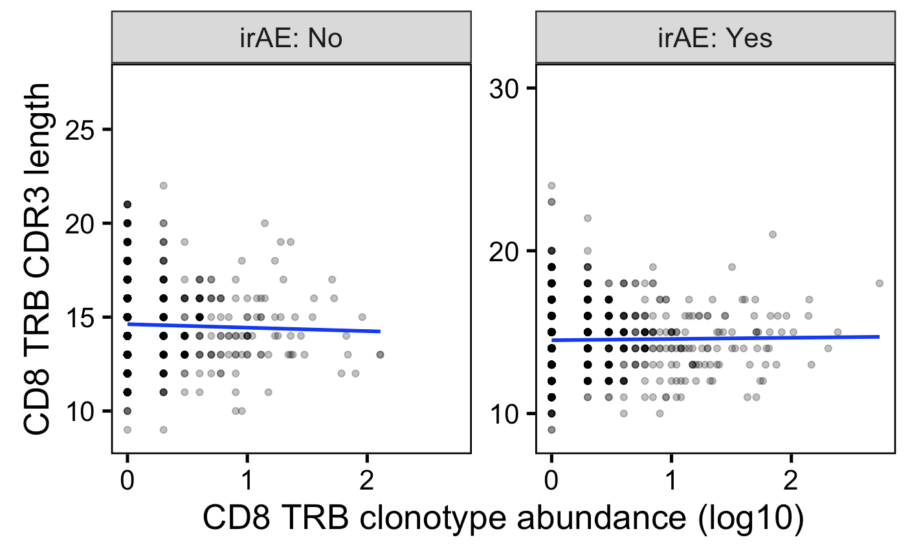
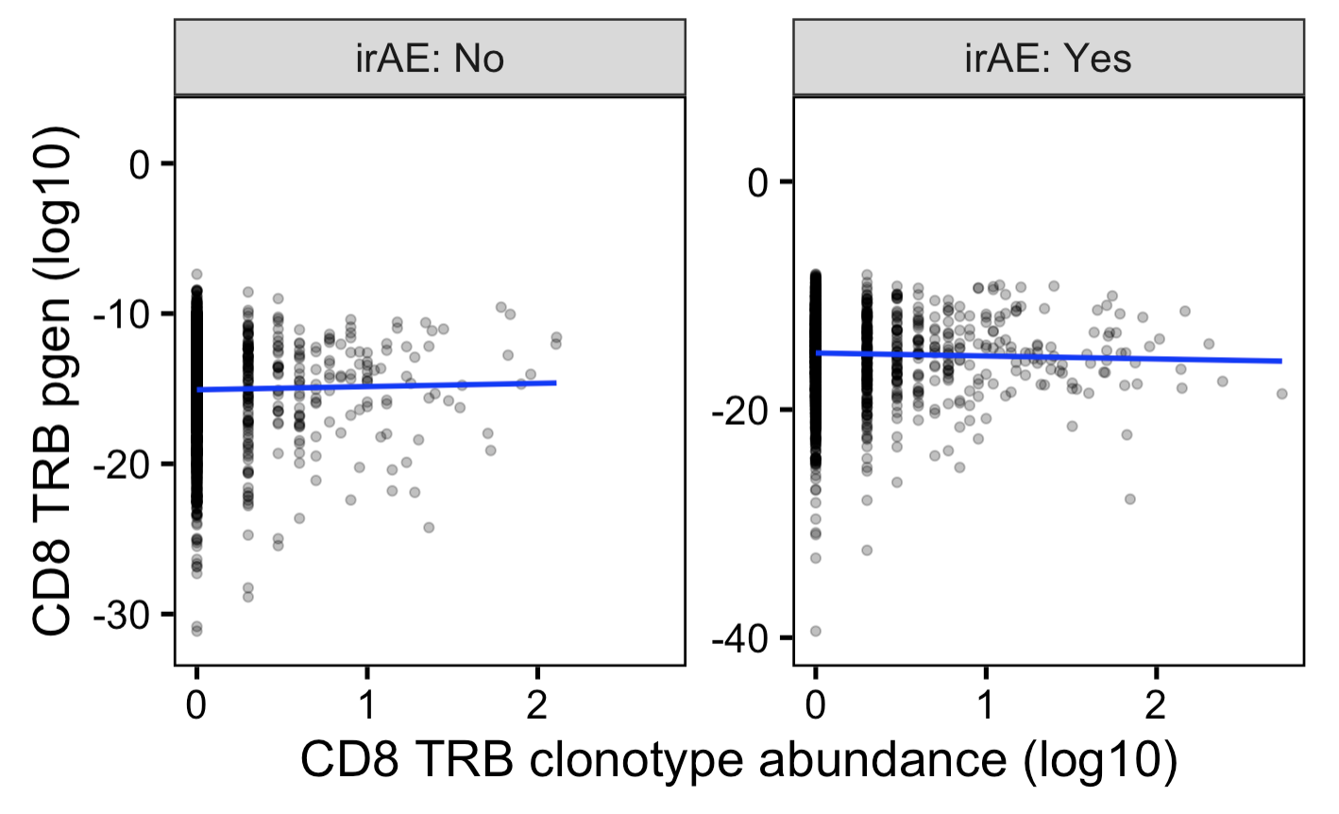
In myocarditis dataset, can see small differences in best fit slopes for feature vs. clonotype abundance plots for yes/no irAE
Unique TCRs
→
More germline-like
Less germline-like
→
Notes:
Slope differences much bigger if no log10 x-axis scale, but then all squished in x-axis

Slide 4
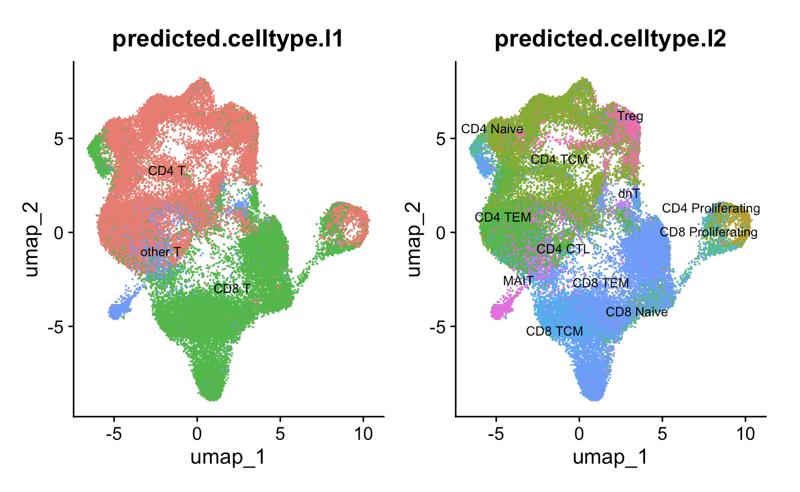
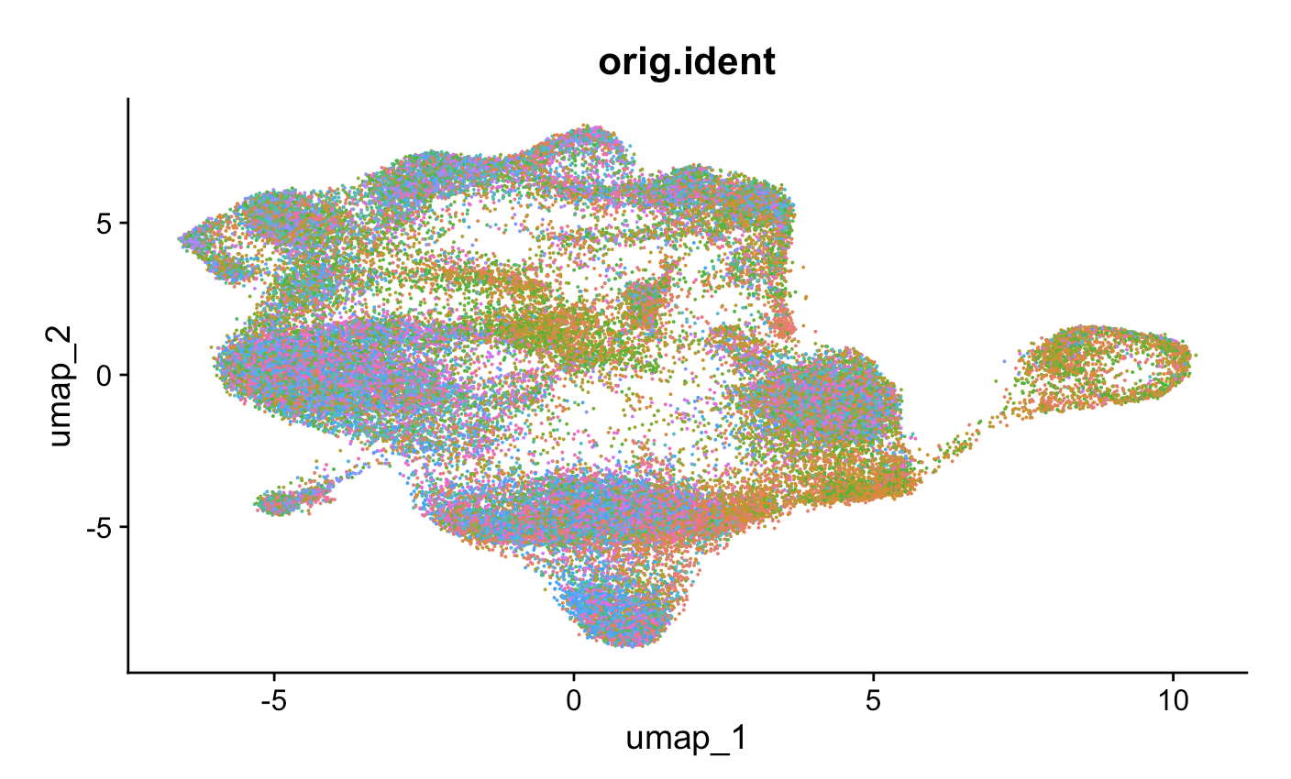
Colitis dataset UMAPs
Patient ID

Slide 5
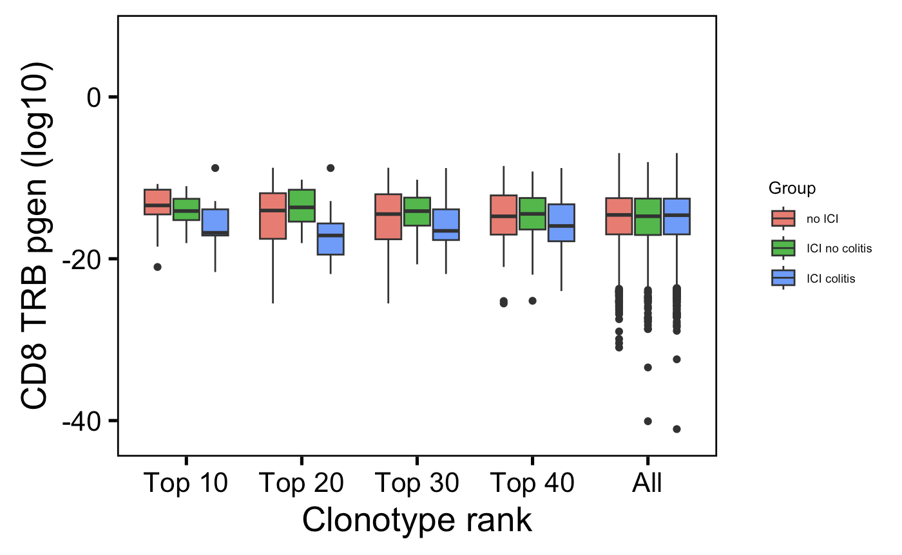
In colitis dataset, CD8 T TRBs are also slightly less germline-like in those developing colitis vs. ICI-no colitis group
**
→
More germline-like
Less germline-like
→
Wilcoxon rank sum test. ****, padj <1e-4; **, padj <1e-2; *; padj <0.05

Slide 6
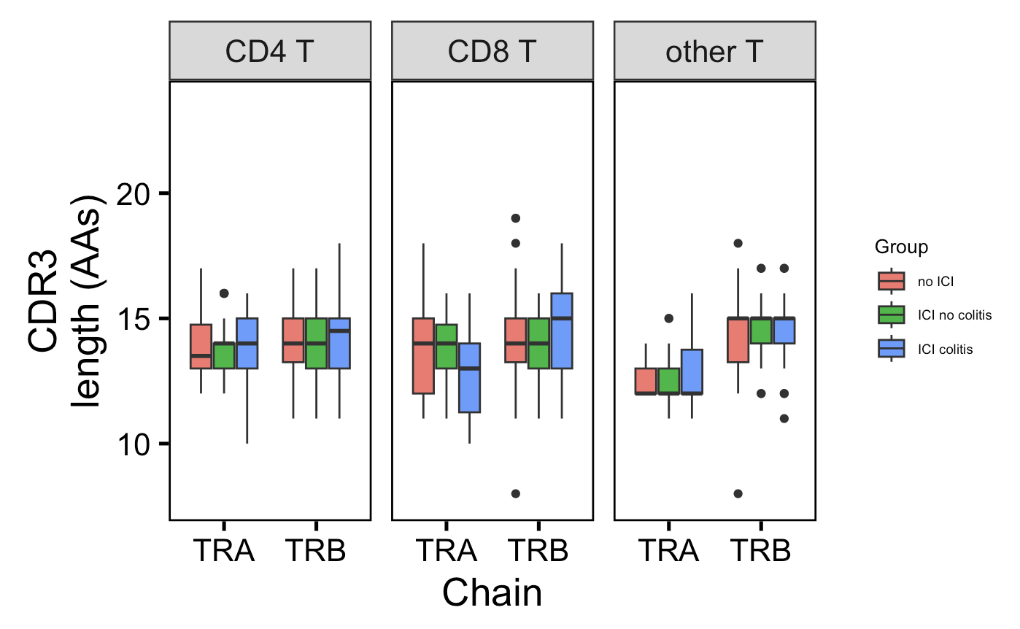
In colitis dataset, there are no junction length differences between patient groups
Unique TCRs from top 30 clonotypes (per chain & cell type) in each patient group

Slide 7
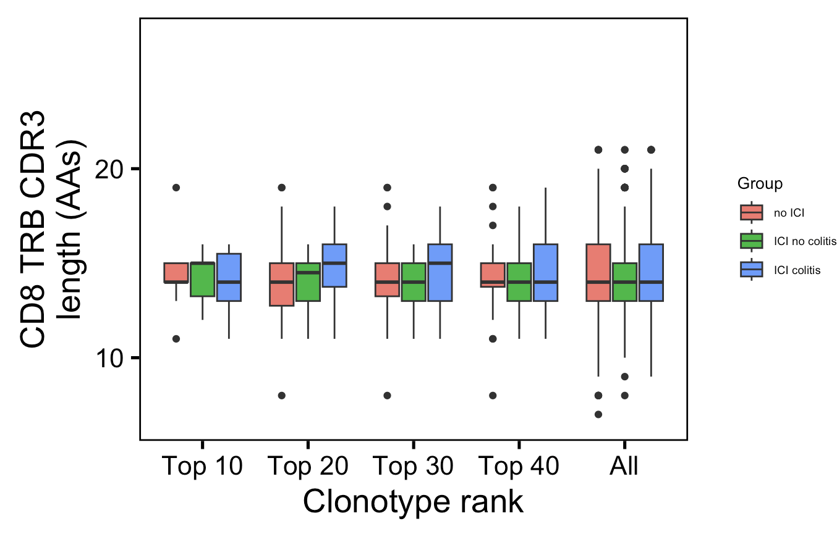
In colitis dataset, there are no CD8 TRB junction length differences between patient groups at any clonotype rank cutoff
Unique TCRs from top 30 clonotypes (per chain & cell type) in each patient group

Slide 8
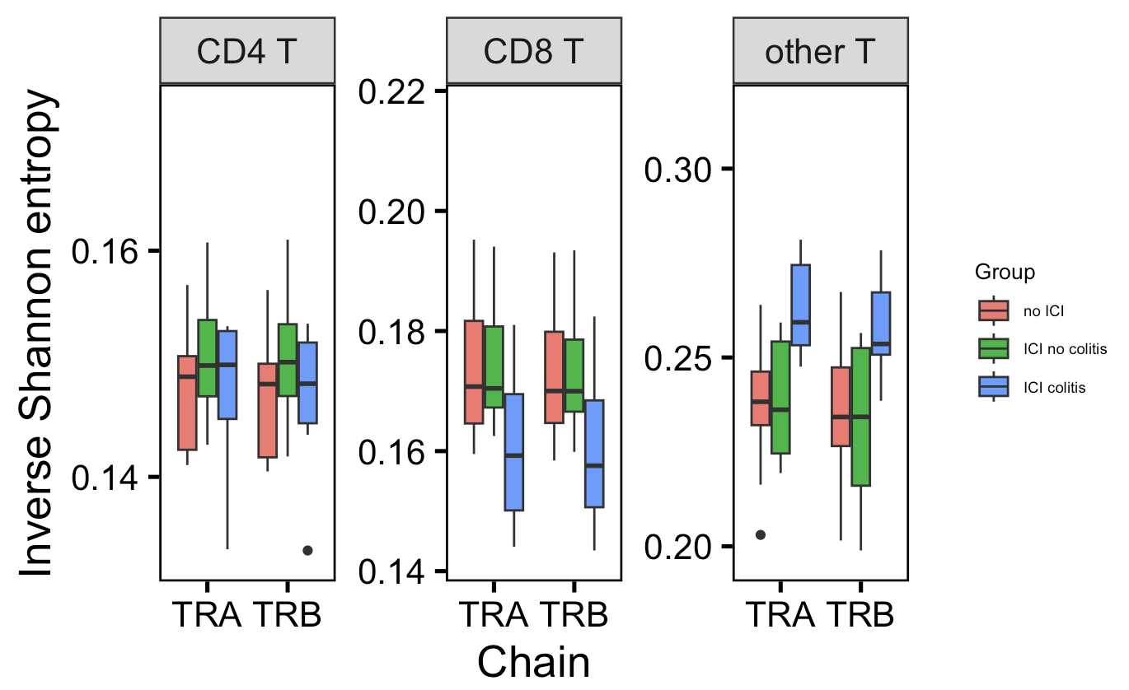
In colitis dataset, CD8 TCR repertoire slightly more polyclonal and other T TCR repertoire more monoclonal in those developing colitis irAE (vs. no ICI)
p =
0.09
p =
0.09
*
*
*
→
More monoclonal
More polyclonal
→
Wilcoxon rank sum test. ****, padj <1e-4; **, padj <1e-2; *; padj <0.05

Slide 9
Conclusions
In both datasets, CD8 TRBs are less germline-like in those developing colitis irAE
Less solid in colitis dataset than in myocarditis dataset
However, do not see longer CD8 TRB CDR3s in colitis dataset as we saw in myocarditis dataset
Uniquely in colitis dataset, see TCR repertoire diversity differences between irAE groups
No hydrophobicity differences in colitis dataset (data not shown)

Slide 10
Next steps
Check V(D)JC gene usage differences by irAE group in colitis dataset
Perhaps an alternative explanation for pgen differences if CDR3 lengths are the same
Checking for TCR matches from VDJdb and neoantigen TCR phenotype paper in irAE datasets
Practice ATAC-seq analysis for ITN ATAC study
Notes:
ITN ATAC study - Better defining Tex in teplizumab treated subjects to inform combination treatments

Slide 11
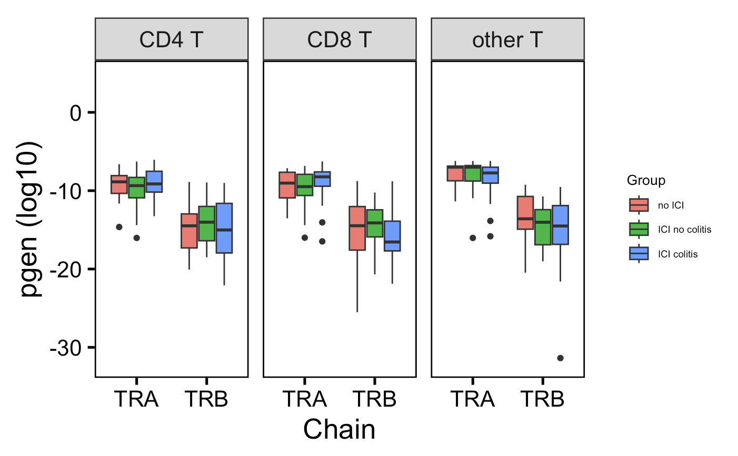
In colitis dataset, CD8 T TRBs are slightly less germline-like in ICI-colitis group vs. ICI-no colitis group
Unique TCRs from top 30 clonotypes (per chain & cell type) in each patient group
→
p = 0.07
More germline-like
Less germline-like
→
Wilcoxon rank sum test. ****, padj <1e-4; **, padj <1e-2; *; padj <0.05

Slide 12
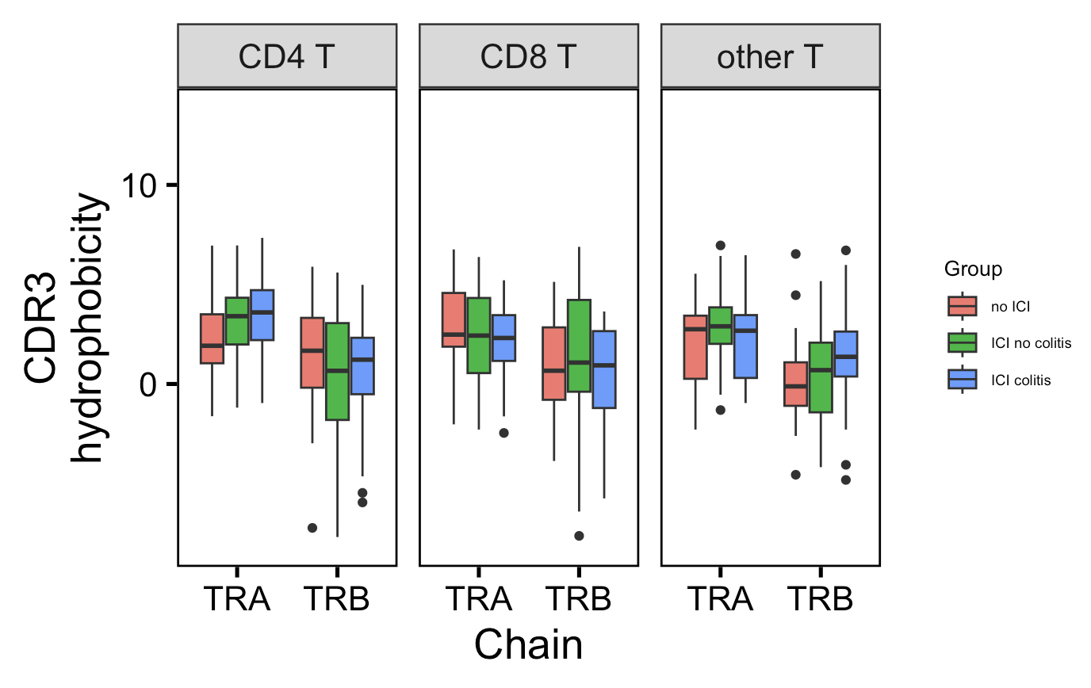
In colitis dataset, there are no junction hydrophobicity differences between patient groups
Unique TCRs from top 30 clonotypes (per chain & cell type) in each patient group

Slide 13
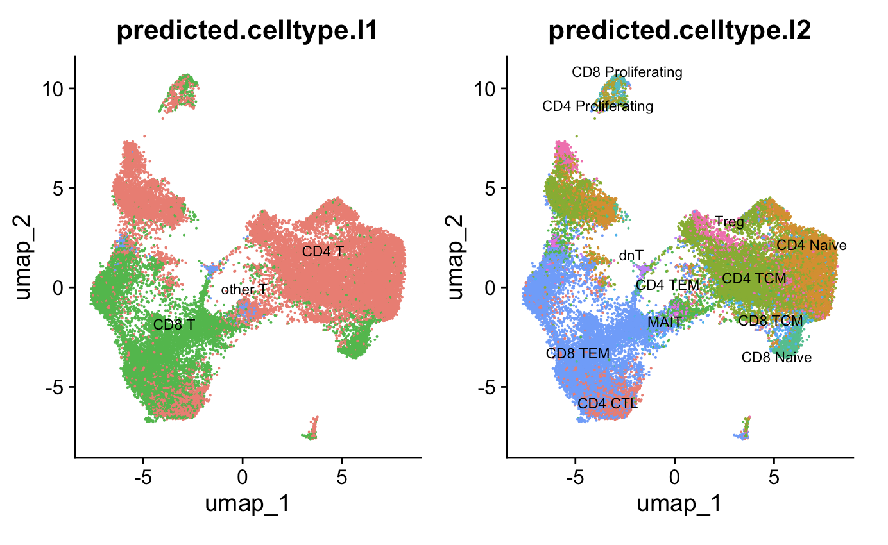
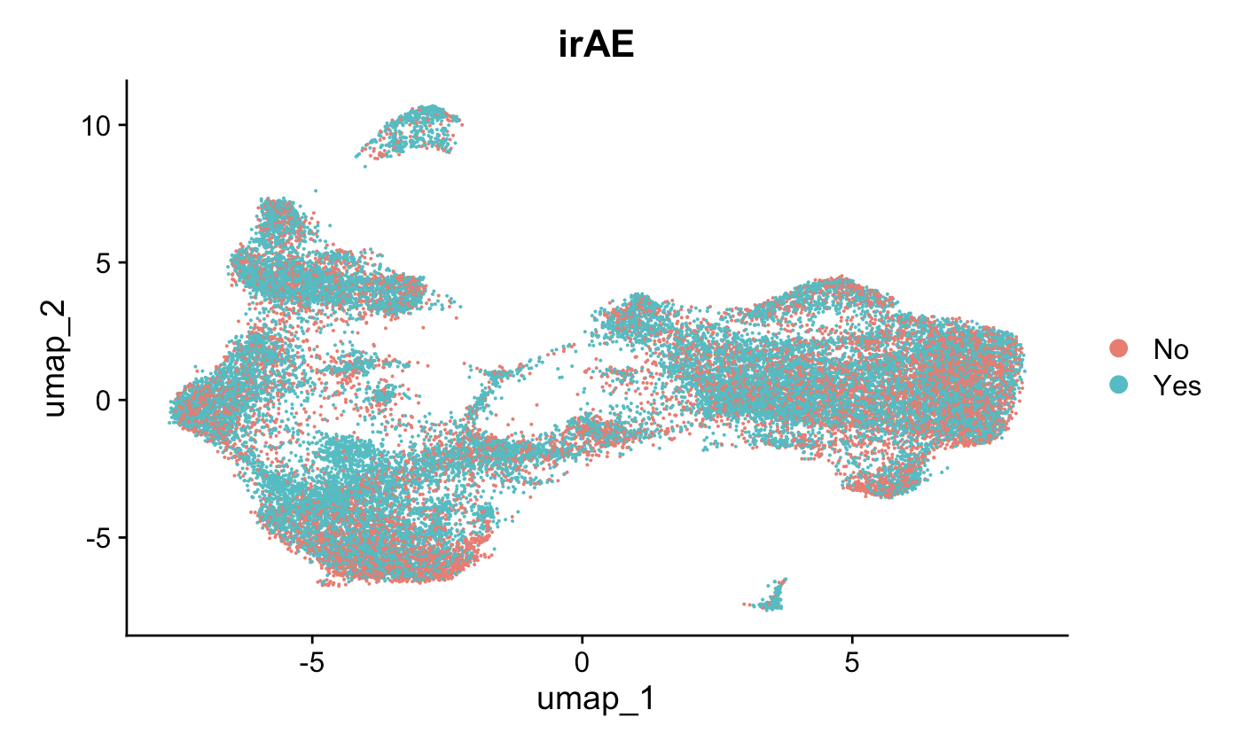

In myocarditis dataset, there is a significant association between cell type (l2) and irAE grouping
irAE
p < 2e-16, Pearson’s Chi-squared test
Notes:
Pearson's Chi-squared test data: contingency_table X-squared = 1185.3, df = 11, p-value < 2.2e-16

Slide 14
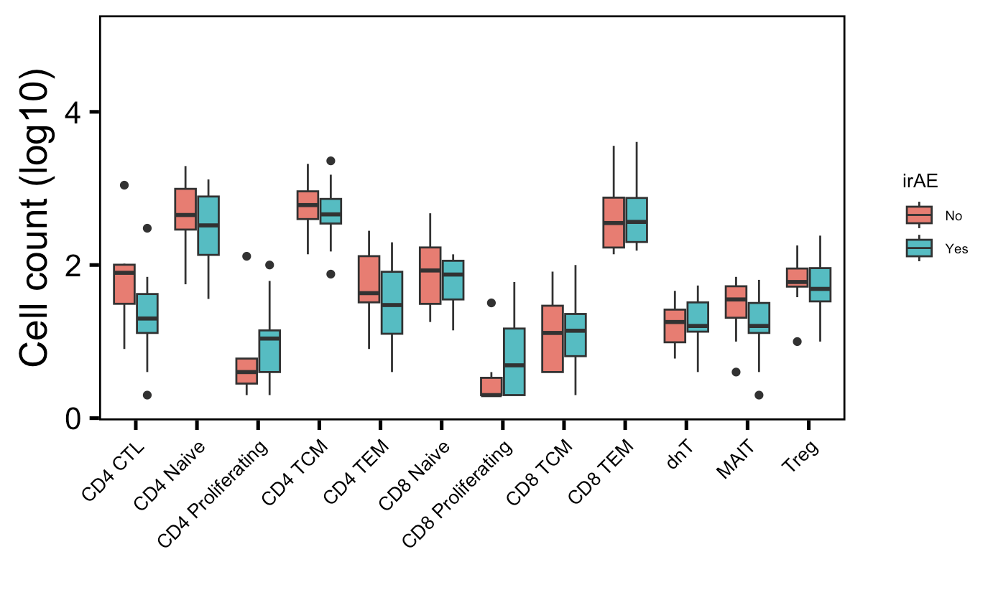
In myocarditis dataset, slightly fewer cytotoxic CD4s in patients developing irAEs
p = 0.08

Slide 15
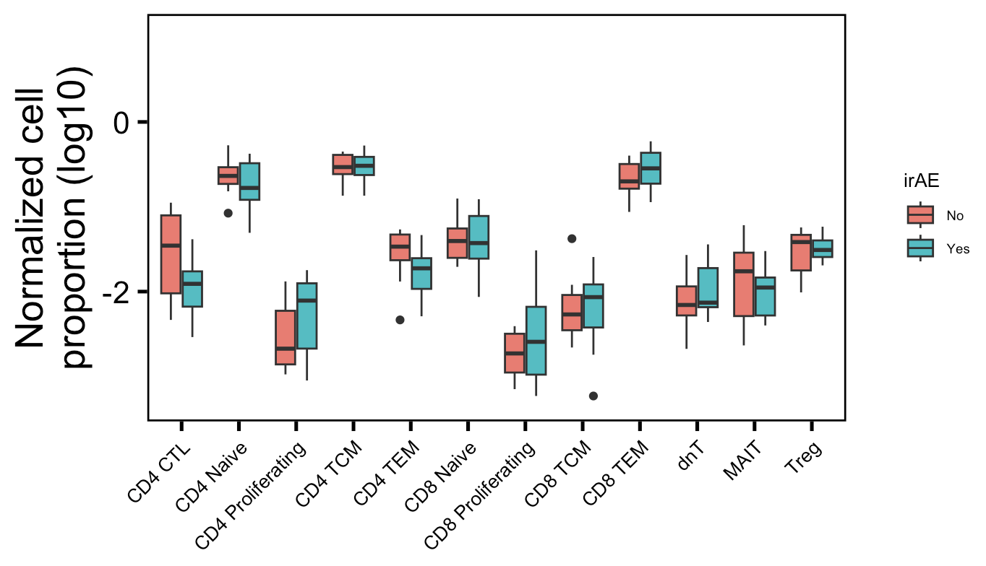
In myocarditis dataset, no longer see significant differences between irAE groups by cell type if counts normalized

Slide 16
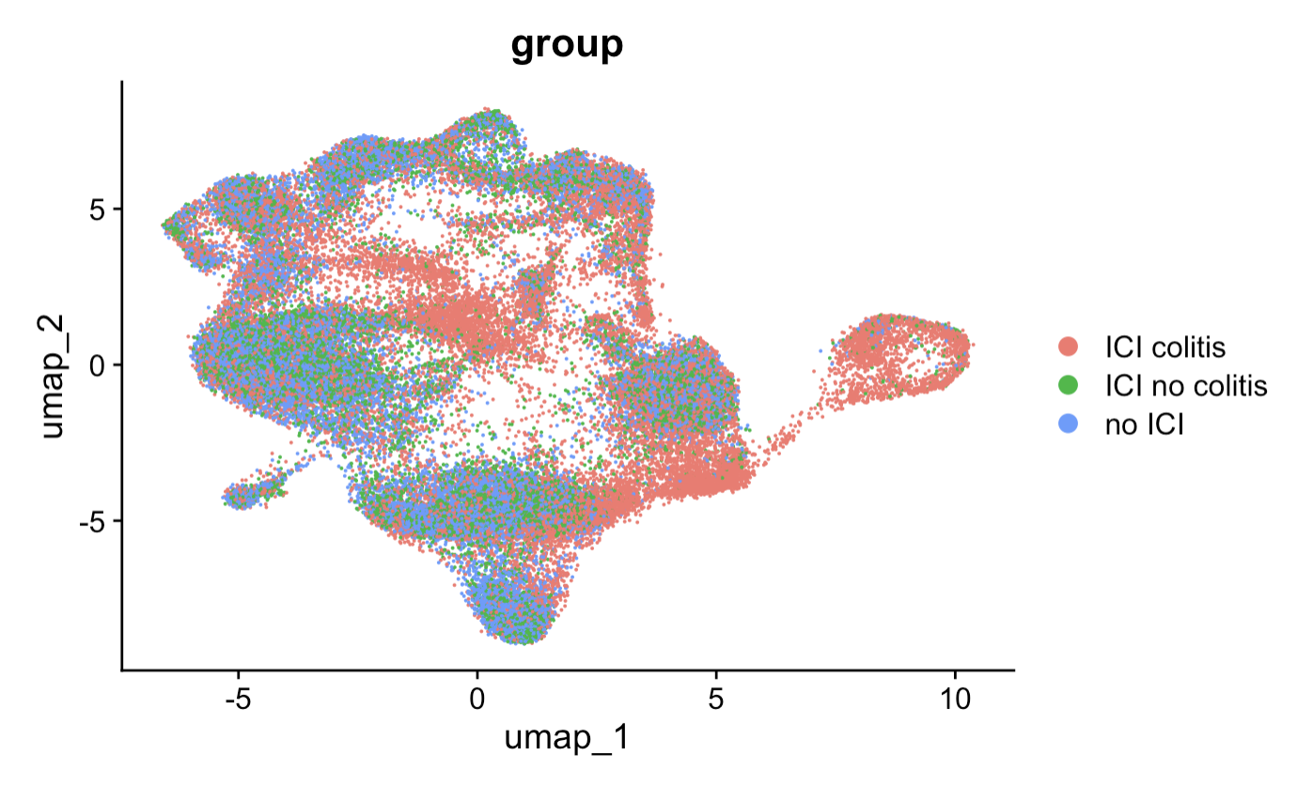

In colitis dataset, there is also a significant association between cell type (l2) and patient grouping
p < 2e-16, Pearson’s Chi-squared test
Notes:
Pearson's Chi-squared test data: contingency_table X-squared = 14158, df = 22, p-value < 2.2e-16

Slide 17
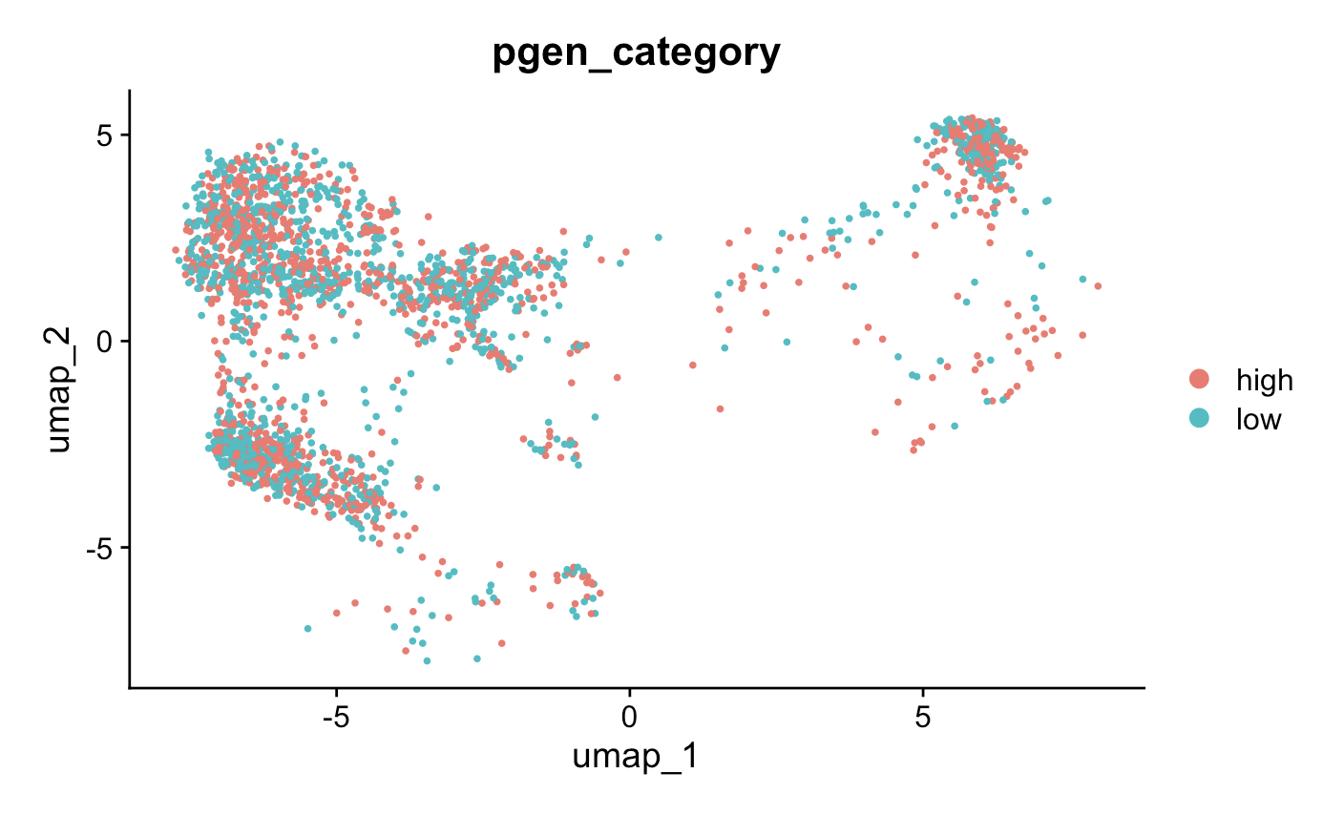
In myocarditis dataset, low and high pgen scores (from CD8 TRBs) do overlap on UMAP, not expecting RNA phenotype differences
Notes:
UMAP is different here because I re-ran code and had been working with a slightly messed up Seurat object but I think it’s ok…

